Slide 1
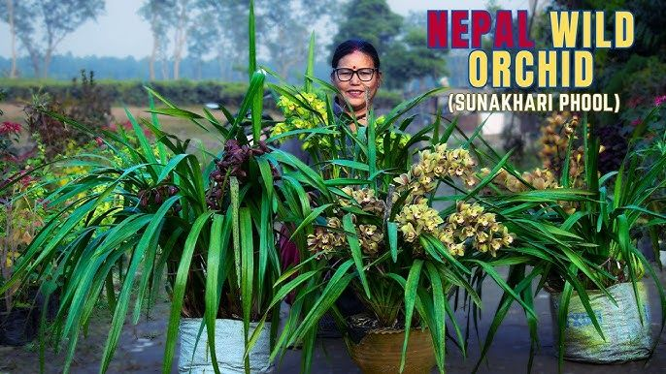

Slide 2
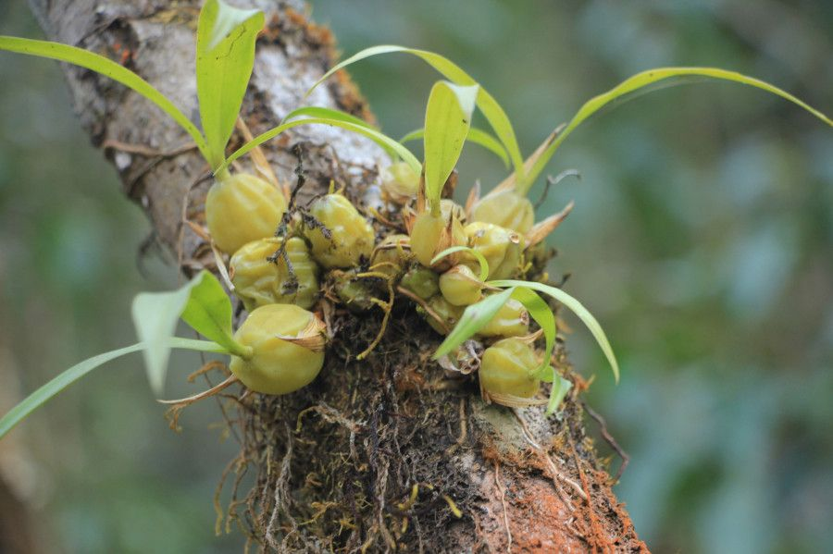

Slide 3


Slide 4
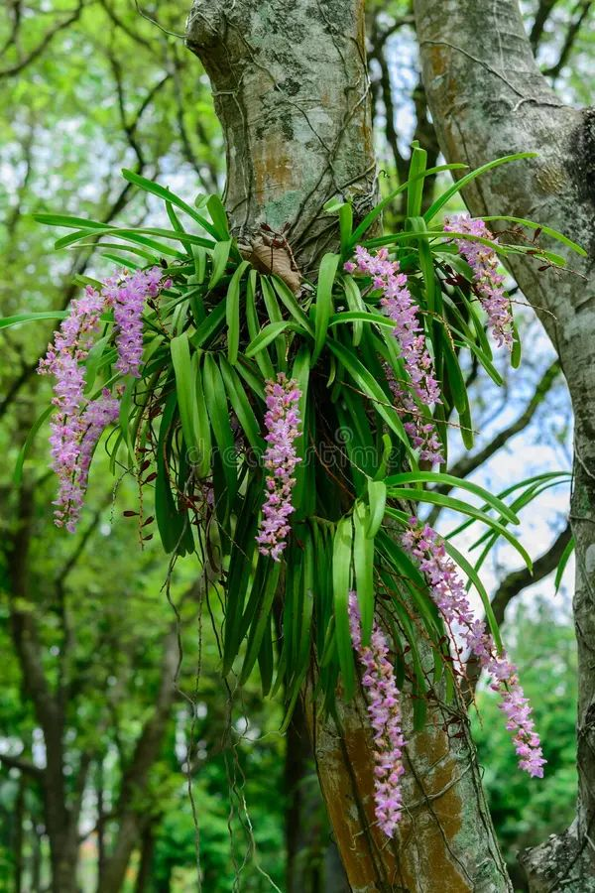
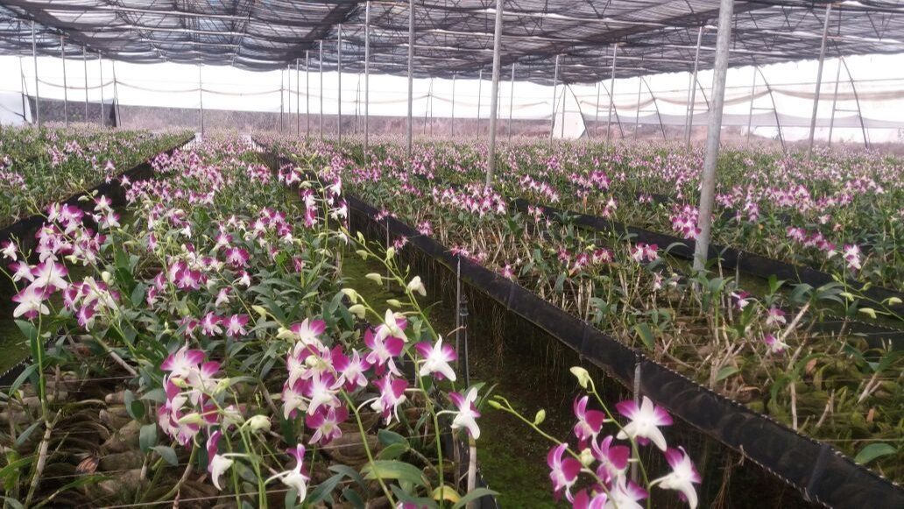
https://fdc.bagamati.gov.np/sites/default/files/2021-09/Orchid%20cultivation%20technology.pdf

Slide 5

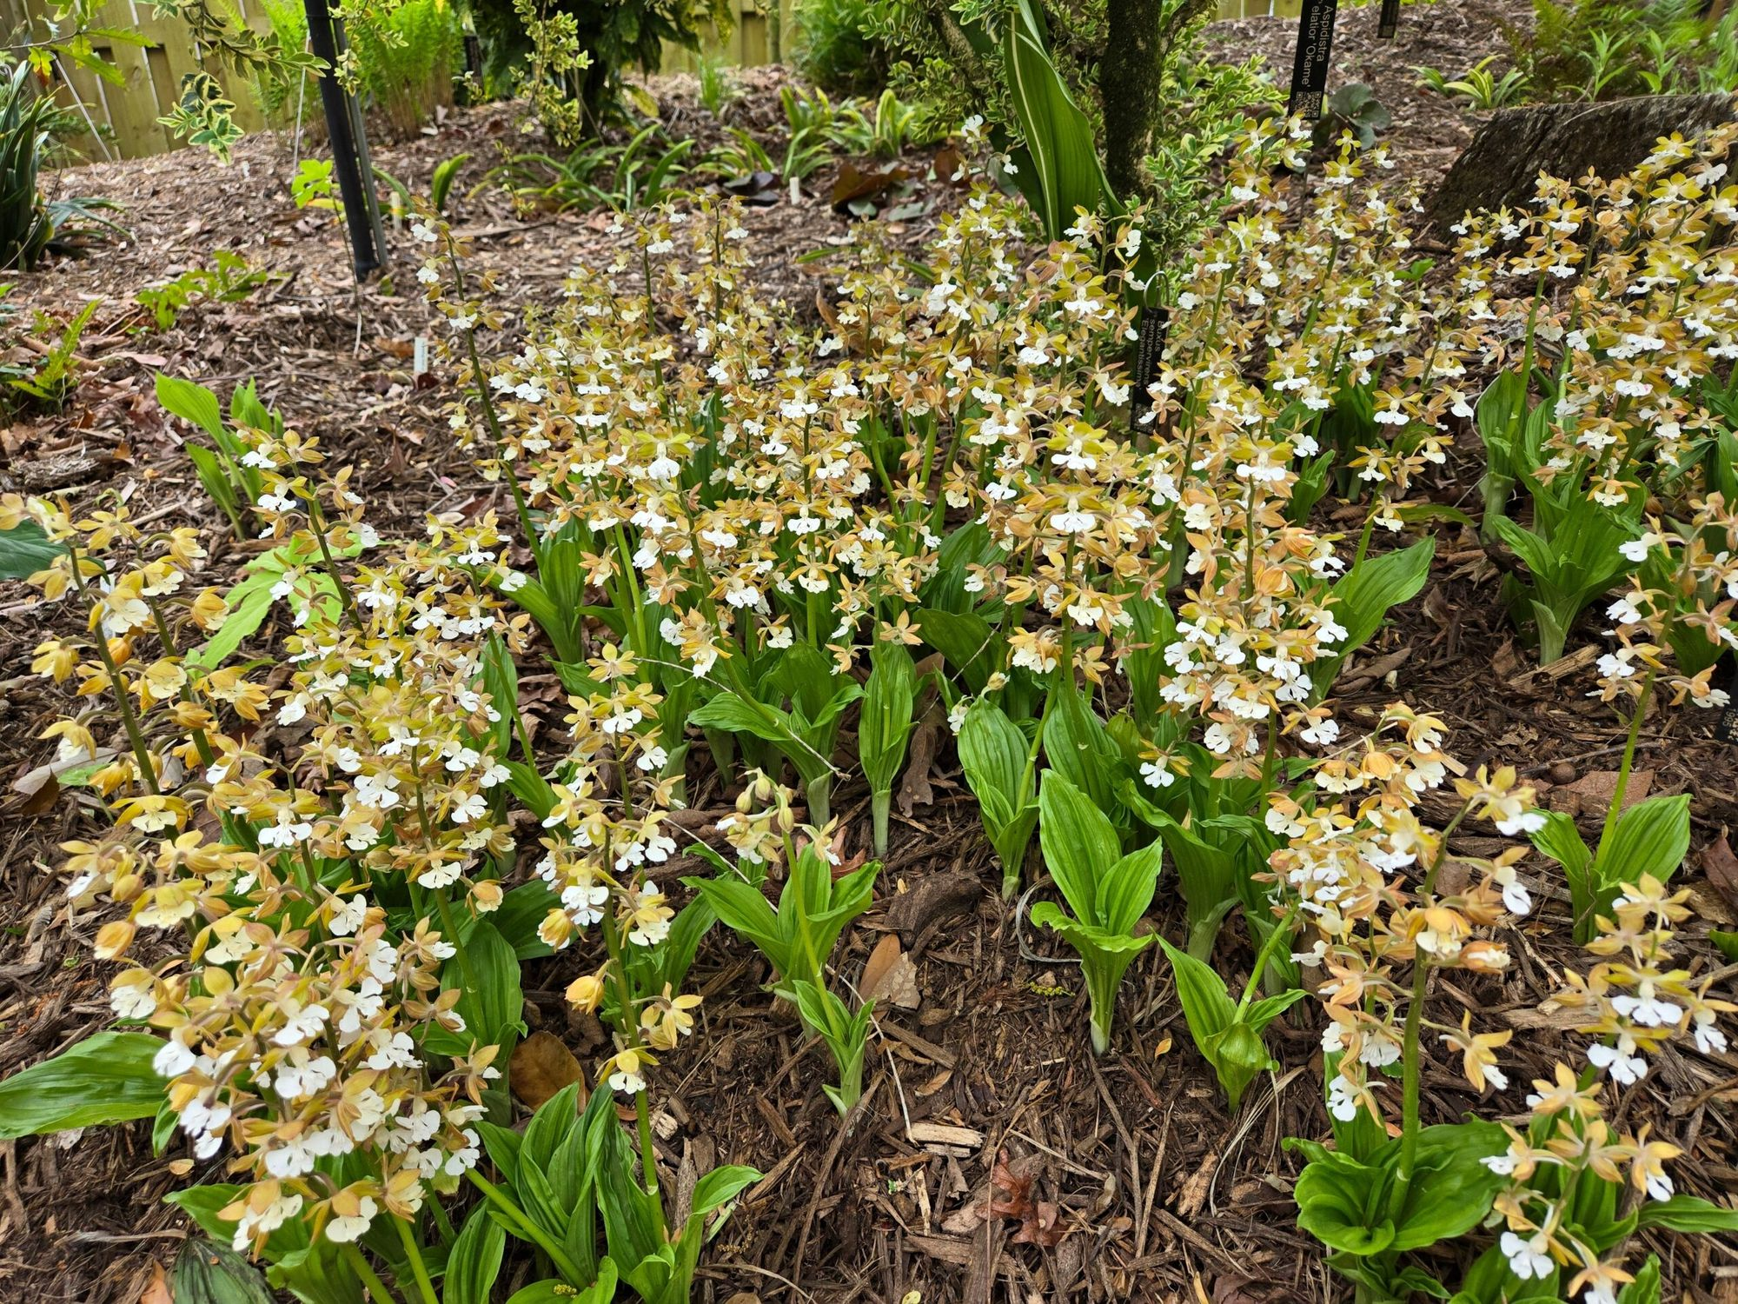
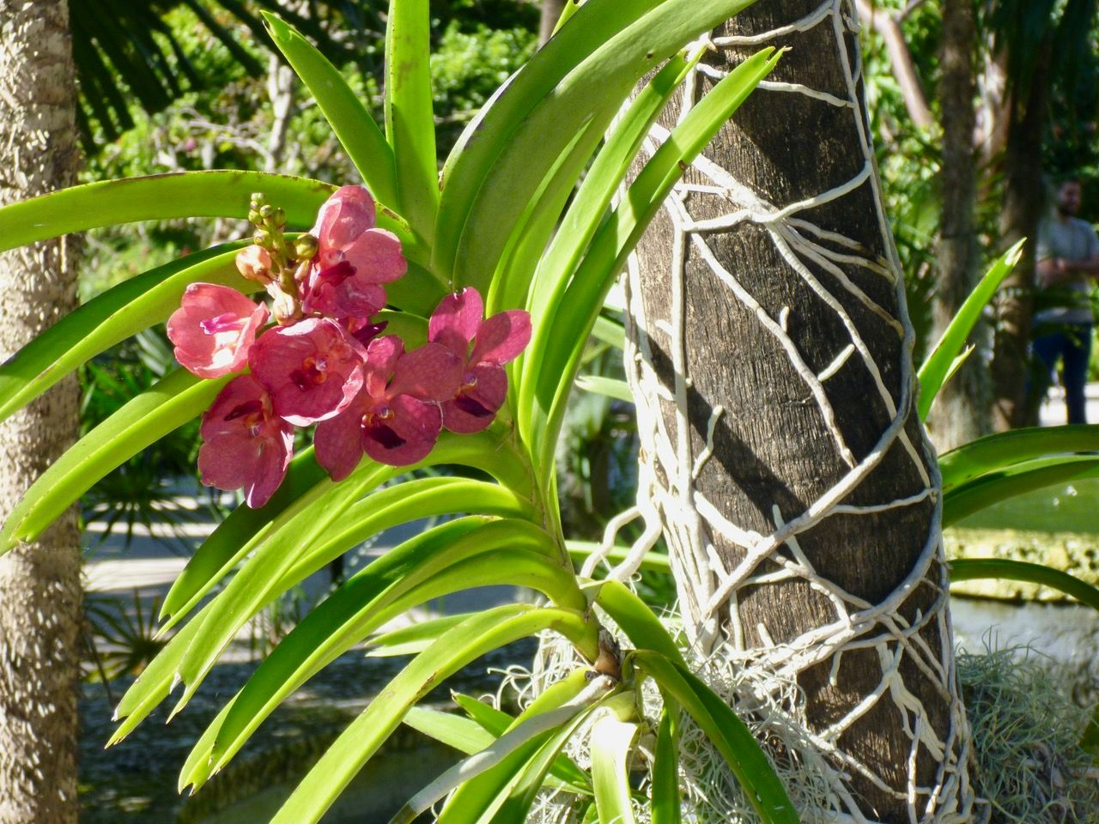
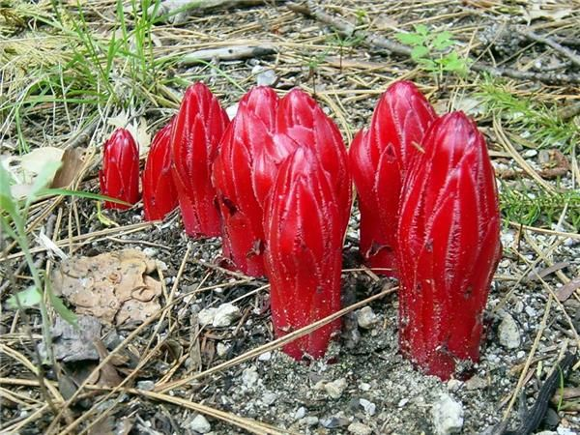

Slide 6
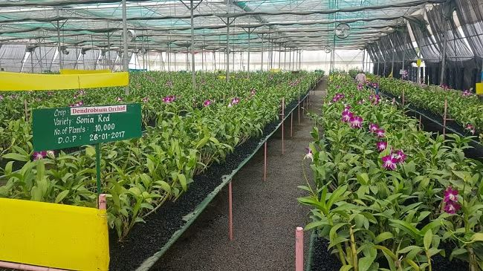

Slide 7

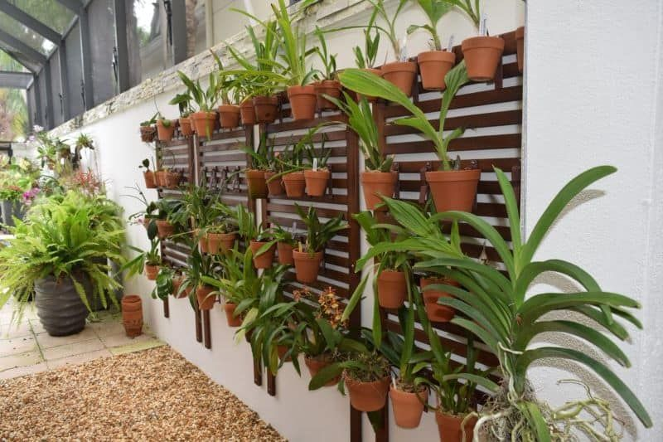

Slide 8
Types of Orchids Based on Habitat
1. Epiphytic Orchids
Examples: Phalaenopsis (Moth Orchid), Cattleya, Dendrobium
Nutrient Source: Absorb moisture and nutrients from the air, rain, and organic debris around them.
2. Saprophytic Orchids
Examples: Corallorhiza (Coral Root), Neottia (formerly Listera)
Nutrient Source: Obtain nutrients from decaying organic matter and rely on mycorrhizal fungi for nutrient absorption.
3. Lithophytic Orchids
Examples: Dendrobium nobile, Cymbidium
Nutrient Source: Absorb moisture and nutrients from the air and rain, growing on rocky surfaces.
4. Terrestrial Orchids
Examples: Orchis (Common Orchid), Cypripedium (Lady's Slipper)
Nutrient Source: Absorb nutrients directly from the soil where they are rooted.

Slide 9
Soil and Climatic Requirements
Orchids generally prefer well-draining potting media. Common ingredients include:
Fir bark/ Tree Bark
Sphagnum moss
Coconut coir
Perlite or lava rock for aeration
Charred log
Climatic Conditions:
Temperature: Most orchids thrive in temperatures between 18°C at night and 24-30°C during the day. Some species can tolerate lower temperatures during dormancy.
Humidity: Ideal humidity levels range from 60% to 80%. Misting or using humidifiers can help maintain these levels indoors
Light: Orchids generally require bright, indirect light. For example, Cymbidiums need about 50% shade during hot weather

Slide 10
Orchid Propagation Methods
1.Division
Splitting a mature sympodial orchid into two or more sections, each with roots and pseudobulbs.
Examples: Dendrobium, Cattleya.
2.Backbulbs
Using dormant pseudobulbs (backbulbs) from the parent plant to grow new orchids by encouraging growth from dormant nodes. Examples: Cymbidium.
3.Stem Cuttings
Cutting the stem of monopodial orchids to create new plants; the cut section is rooted in a suitable medium. Examples: Phalaenopsis, Vanda.
4.Keiki (Baby Orchids)
Removing small plantlets (keikis) that develop on the flower stalk or nodes, which can be potted separately. Examples: Phalaenopsis, Dendrobium.
5.Micropropagation (Meristem Cloning)
A laboratory technique where plant cells are cultured in a nutrient medium to produce clones of the parent plant. Examples: Various orchid species, commonly used for mass production.
6.Seed Propagation
Collecting and sowing seeds, which requires specific conditions for germination and may involve mycorrhizal fungi for nutrient absorption.
Examples: All orchid types can be propagated this way, though it is more complex.

Slide 11
Planting
Use pots that allow for good drainage. Plastic pots are preferred as they allow easier root management during repotting.
Fill the bottom with drainage materials like foam peanuts or gravel before adding the potting medium
Maturing
Orchids take time to mature; from seed germination to flowering can take several years. Regular care including watering and fertilizing is crucial during this period
Training and Pruning
Training involves using stakes or supports to keep flower spikes upright. Pruning should be done after flowering to encourage new growth and remove dead or damaged parts
Disease and Insect Pest Control
Common pests include aphids, mealybugs, and spider mites. Integrated pest management strategies such as neem oil or insecticidal soaps are effective.
Fungal diseases can be prevented by ensuring proper air circulation and avoiding overwatering
Harvesting
Harvest orchids when flowers are fully opened for maximum vase life. The best time to cut is in the morning. Use sharp tools to avoid damaging the plant
Post-Harvest Practices
After cutting, immediately place the flowers in water to maintain hydration.
Store cut orchids in a cool place away from direct sunlight to prolong freshness

